Slide 1
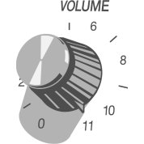
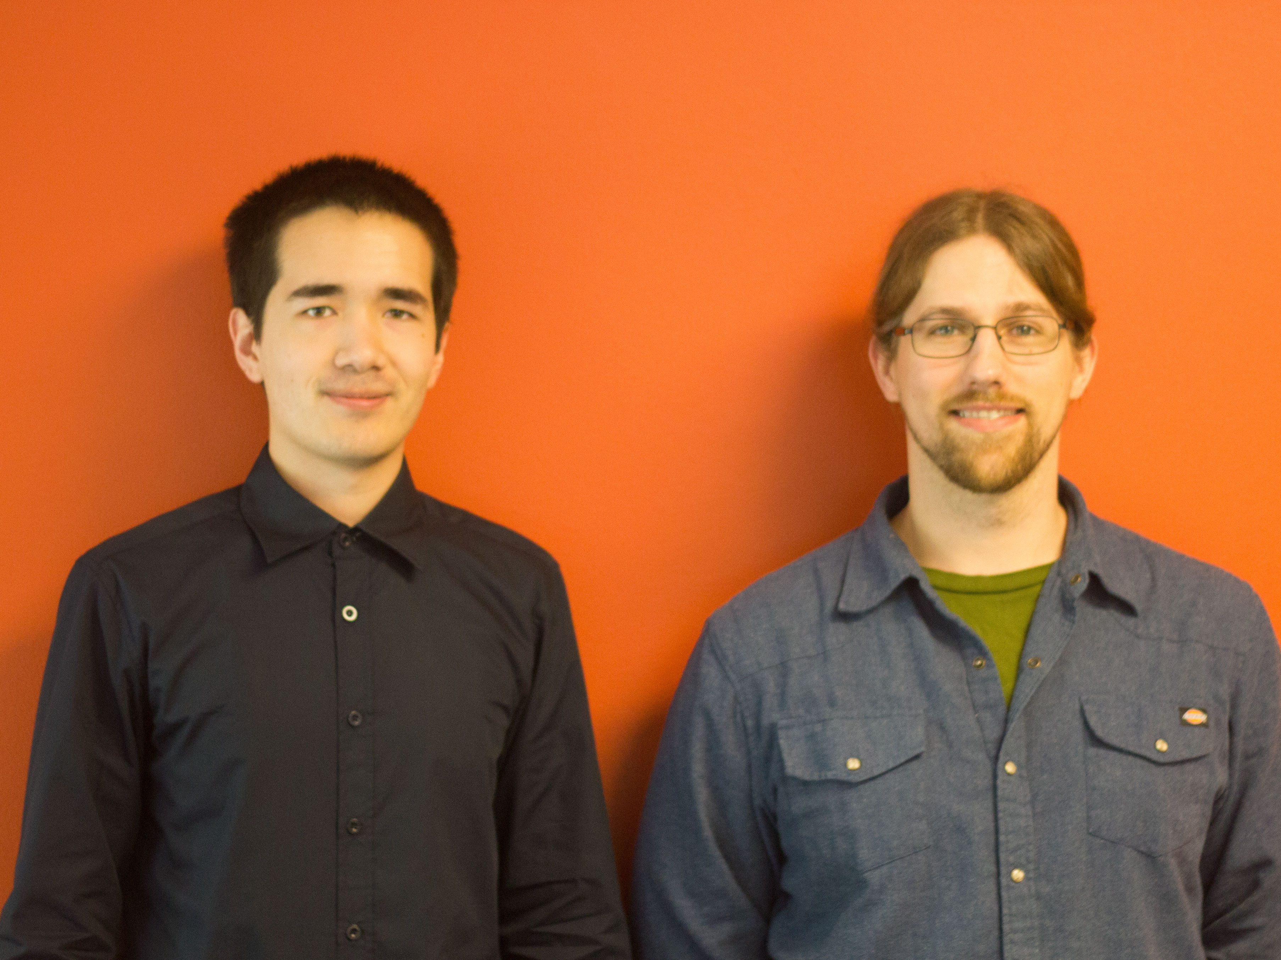
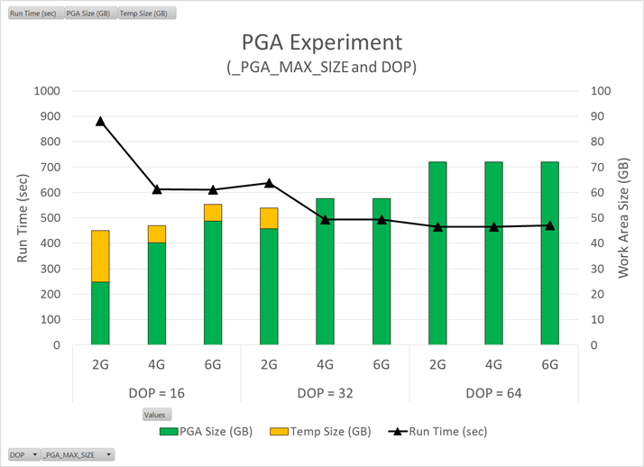
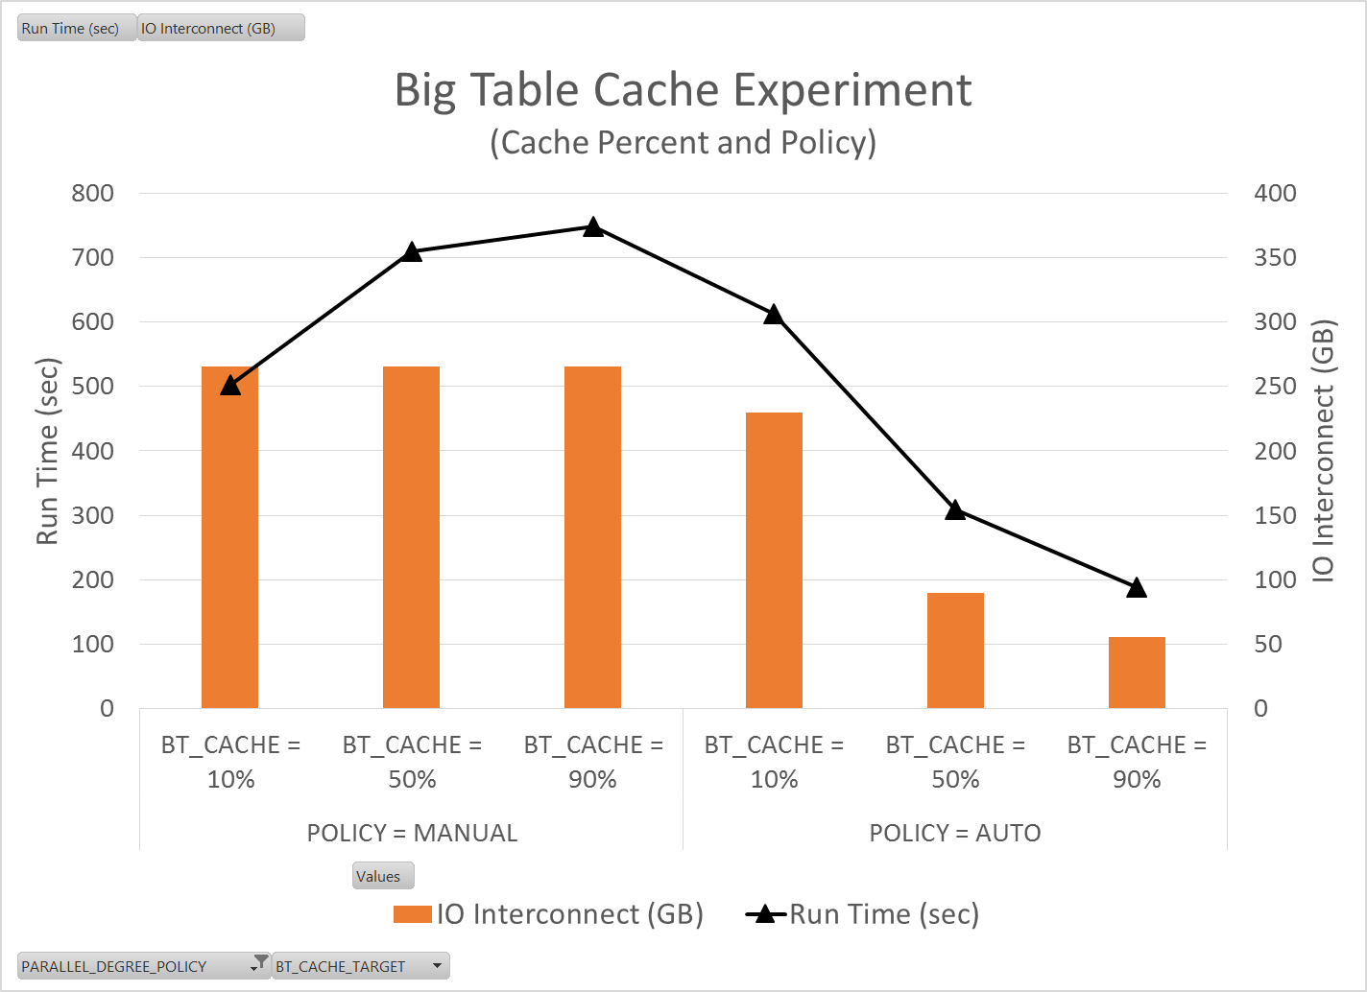
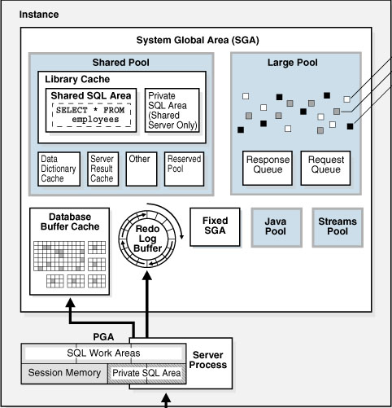
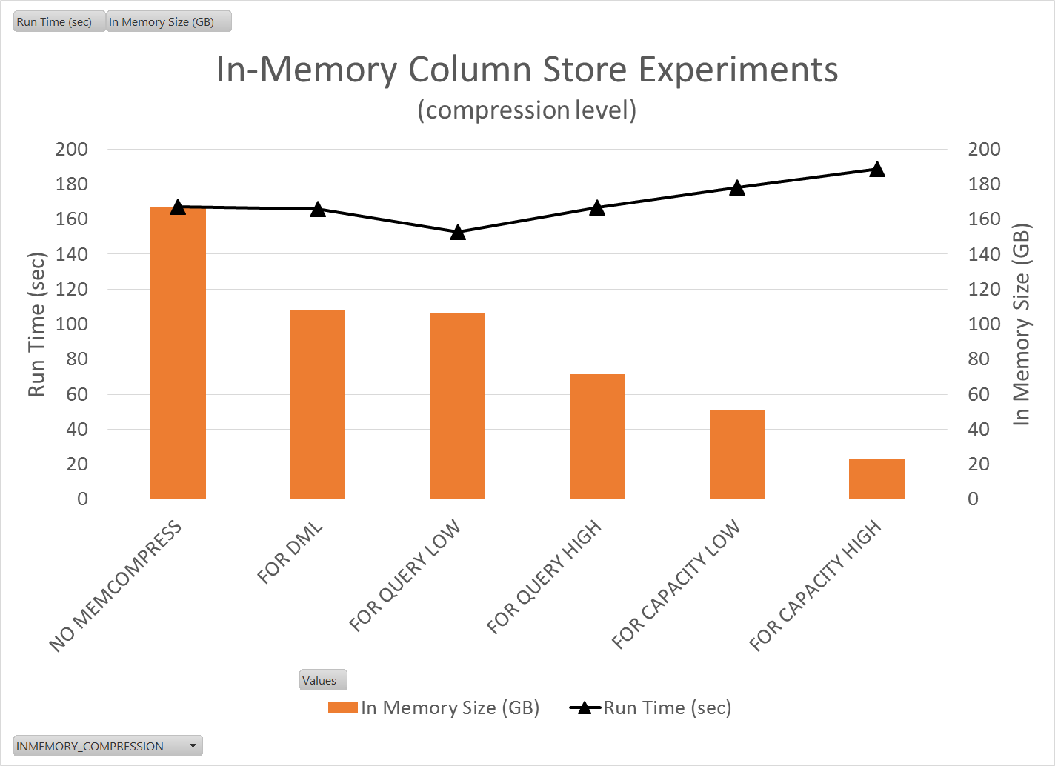
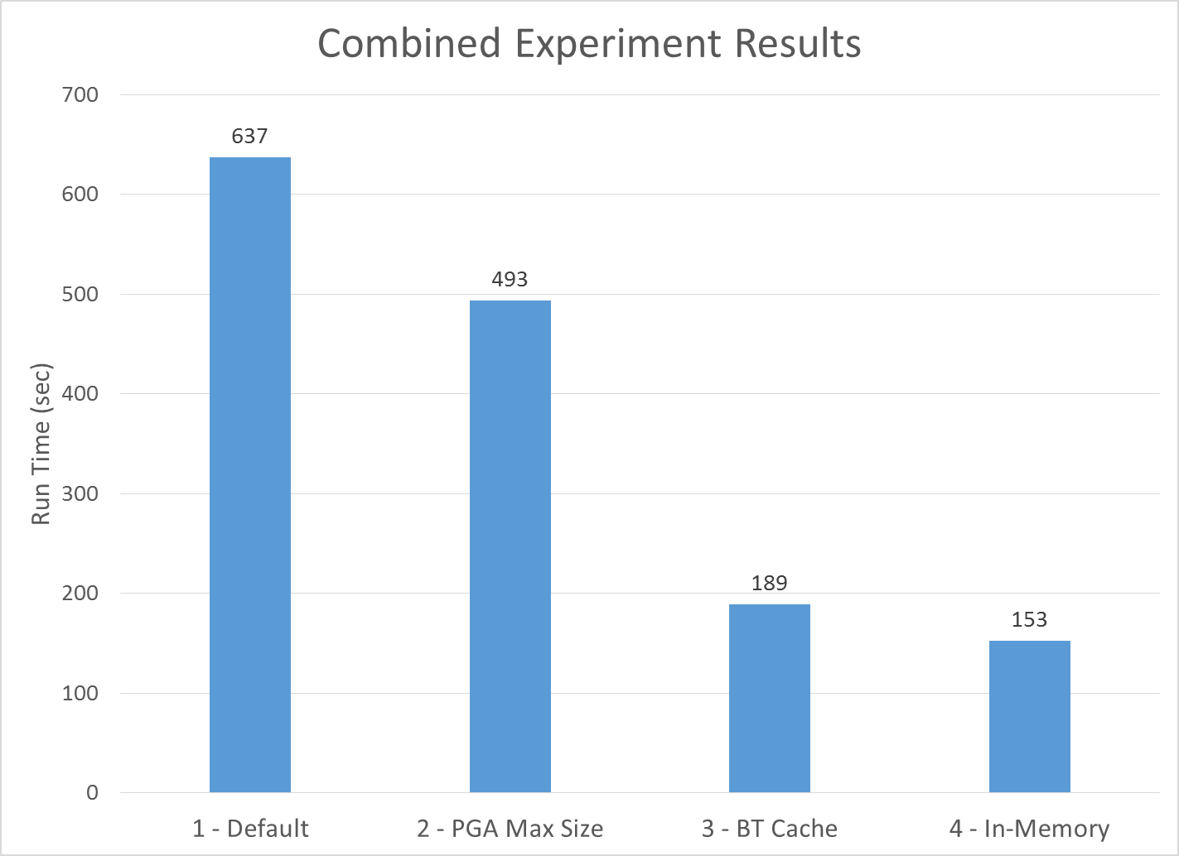

Big Data Analytics:
Drive your server like you stole it
Research Team
Effects of Memory Management and Parallelism
Background Computational efficiency and performance are paramount to being able to quickly and effectively analyze data within a reasonable time frame when working with very large data sets. Oracle 12c performs sub-optimally out of the box when it comes to analyzing the massive amount of telemetry data gathered from HP PageWide Web Press printers. Oracle database is instead setup for Online Transaction Processing (OLTP) workloads by default, which caters to handling many simple queries returning relatively small amounts of data.
Our clients current configuration does not perform optimally for Decision Support System (DSS) workloads, which involve analytical queries performing aggregations over very large sets of data. Because of this, our clients were experiencing very poor database performance for their use case despite having a very high performance server.
Project Description The primary purpose of this project is to research concepts of Oracle database relating to increasing query performance for DSS workloads and experimenting with turning internal performance knobs in the database. Our goal is to identify what knobs to turn and what features to use to increase query throughput. In turn, this will let the database use the server’s resources more efficiently to ultimately reduce query execution time.
Program Global Area (PGA) Parameters Emphasis was placed on both documented and undocumented parameters focused on managing work area size. A specified work area provides the allotment of main memory used to complete an operation such as sort or hash. If a work area size is surpassed, the operation spills to disk to complete the work which causes drastic increase in execution time.
Automatic Big Table Cache Oracle 12c has a new feature which uses a temperature based algorithm to determine which tables considered large should be stored in a cache store located in the SGA. When enabled, stores table after initial scan so benefits are seen upon replicate samples.
In-Memory Column Store Oracle 12c also has a new feature which stores data in columnar format. Objects as specific as columns from a table can be flagged for storage. Blocks from In-Memory storage can be scanned without decompression. Figure 3 shows how the run time for highly compressed tables increases when stored in the IMCS.
Figure 4: Effect of degree of parallelism and PGA size on run time
Overall Results
Increase of undocumented parameter _PGA_MAX_SIZE prevented operations from spilling to temporary tablespace.
Big Table Cache experiment resulted in buffer reads for initial table scans, essentially reducing initial disk IO.
In-Memory Column Store experiment demonstrated the benefits of in memory execution, with the added benefit of scans on compressed columnar data.
Each column in the plot below represents the summation of individual test run times for each experiment. There is a clear decrease in overall run time for each of the three experiments. The most dramatic increase in performance resulted from utilizing the In-Memory Column Store feature. Through these three experiments we were able to quantitatively demonstrate techniques for increasing DSS workload performance.
Team Members:
Nic Desilets desiletn@oregonstate.edu Applied CS: Web & Mobile Development
Nathaniel Whitlock whitlocn@oregonstate.edu Applied CS: Bioinformatics
Clients:
Kirby Sand Data Analyst
Andy Weiss Database Administrator
Affiliation:
Hewlett-Packard Inc. PageWide Web Press
Outcomes:
4x speed improvements
More resource utilization
Increased query throughput
In conclusion, we saw significant performance increases by optimizing database system resource usage and taking advantage of some new features found in Oracle 12c. This was accomplished by increasing PGA workspace size, enabling In-Memory Column Store, and enabling Automatic Big Table Caching.
Figure 2: Effect of buffer gets on IO interconnect and runtime
Figure 1: Database Overview
Figure 3: Effect of various compression rates on run time
Figure 5: Summary of Results
Notes:
If tri-fold mounting at SMS – make sure no text or image is in-between the two vertical guide lines; this space will be cut away. To view the vertical guide lines: Select “View” from the main menu, select “Guides” from the pull down menu, and lastly select “Static Guides”.
# Material removed
Project Desc:
, and developing a plan of changes to implement in the production database to improve database performance for our client's use cases.

